Slide 1
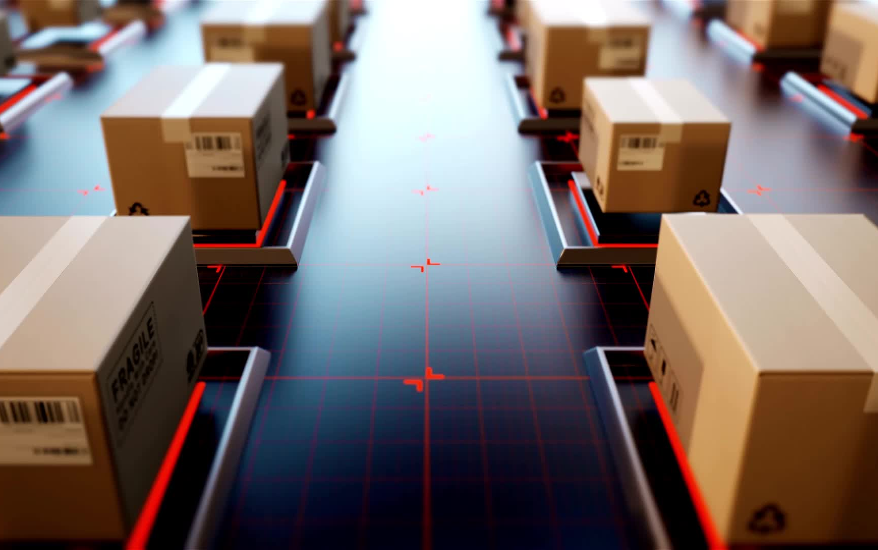
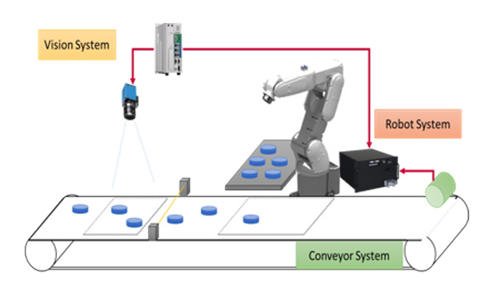
THESIS TOPIC: CONVEYOR TRACKING

Slide 2

CONTENTS :
1. INTRODUCTION
2. WORKING IDEA
3. WHAT NEED TO BE DONE?
4. ENVIRONMENTAL MODEL
5. IMPORTANCE AND IMPORVEMENTS
6. CONCLUSION

Slide 3
INTRODUCTION:
The CONVEYOR TRACKING in modern production having cobots in conjunction with Vision CAMERAS is an innovative technique.
This is DYNAMICALLY INTERACT with MOVING GOODS ON A CONVEYOR BELT,
With the use of VISION CAMERAS, cobots can accurately DETECT, LOCATE, AND TRACK THINGS in real-time even when their shape, speed, or orientation change.
The cobot can now perform tasks LIKE SORTING, ASSEMBLY, AND PICK-AND-PLACE with minimal help from humans thanks to the integration of vision technology.

Slide 4
WORKING IDEA
The conveyor tracking system includes a TARGET POSITION at which a MOVING OBJECT is detected by a SENSOR connected as an input probe to the conveyor drive.
When the object moving on the conveyor is detected, its EXACT POSITION is captured with a VISION SYSTEM takes a SNAPSHOT and computes the XYR COORDINATES OF THE OBJECT.
By knowing the DISTANCE BETWEEN the trigger position and the beginning of the working window (upstream position), the robot can be positioned to the conveyor (captured position + distance offset).
Once the object enters the WORKING WINDOW, the robot will move to it; ONCE SYNCHRONIZED with the conveyor, it can act as the object.

Slide 5
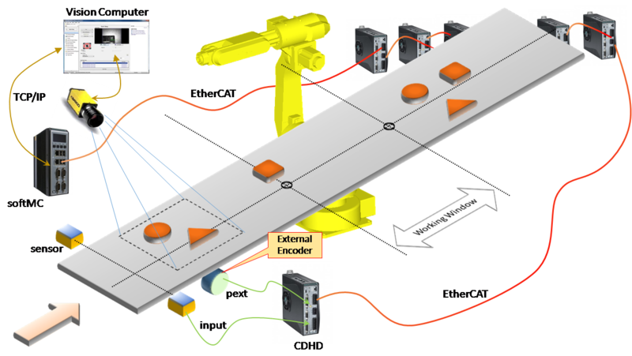

Slide 6
What needs to be done?
Step 1: IDENTIFY THE COORDINATE SYSTEMS:
MACHINE COORDINATE SYSTEMS (MCS)
TOOL COORDINATE SYSTEMS (TCS)
TOOL PLATE COORDINATE SYSTEMS (TPCS)
PART COORDINATE SYSTEMS(PCS)(object)
TOOL CENTRE POINT (TCP)
WORLD COORDINATE SYSTEMS (WCS)
AXIS COORDINATE SYSTEMS (ACS)(motor coordinate system)

Slide 7
Step 2:FUNCTION BLOCK:
COMPONENTS NEED TO BE CREATED TO WORK:
ROBOT SPEED AND POSITION
CONVEYOR SPEED AND POSITION
OBJECT DETECTION
PICK POSE COORDINATOR
CAMERA POSITION
PLACE POSITION

Slide 8
How step 2 to be done?
Define the INITIAL POSITION of the object
Put an OFFSET for the object (Conveyor belt origin)
Using a CAMERA we can detect the initial position of the object
Define the WORKING ZONE (have start zone: distance from the initial object position
to sync zone and end distance: distance between the initial position of the object and
end of sync zone). ( Trying to move the robot with ServoX with Neurapy for fast motion)
Track options (it includes the sync zone and sync out zone)

Slide 9
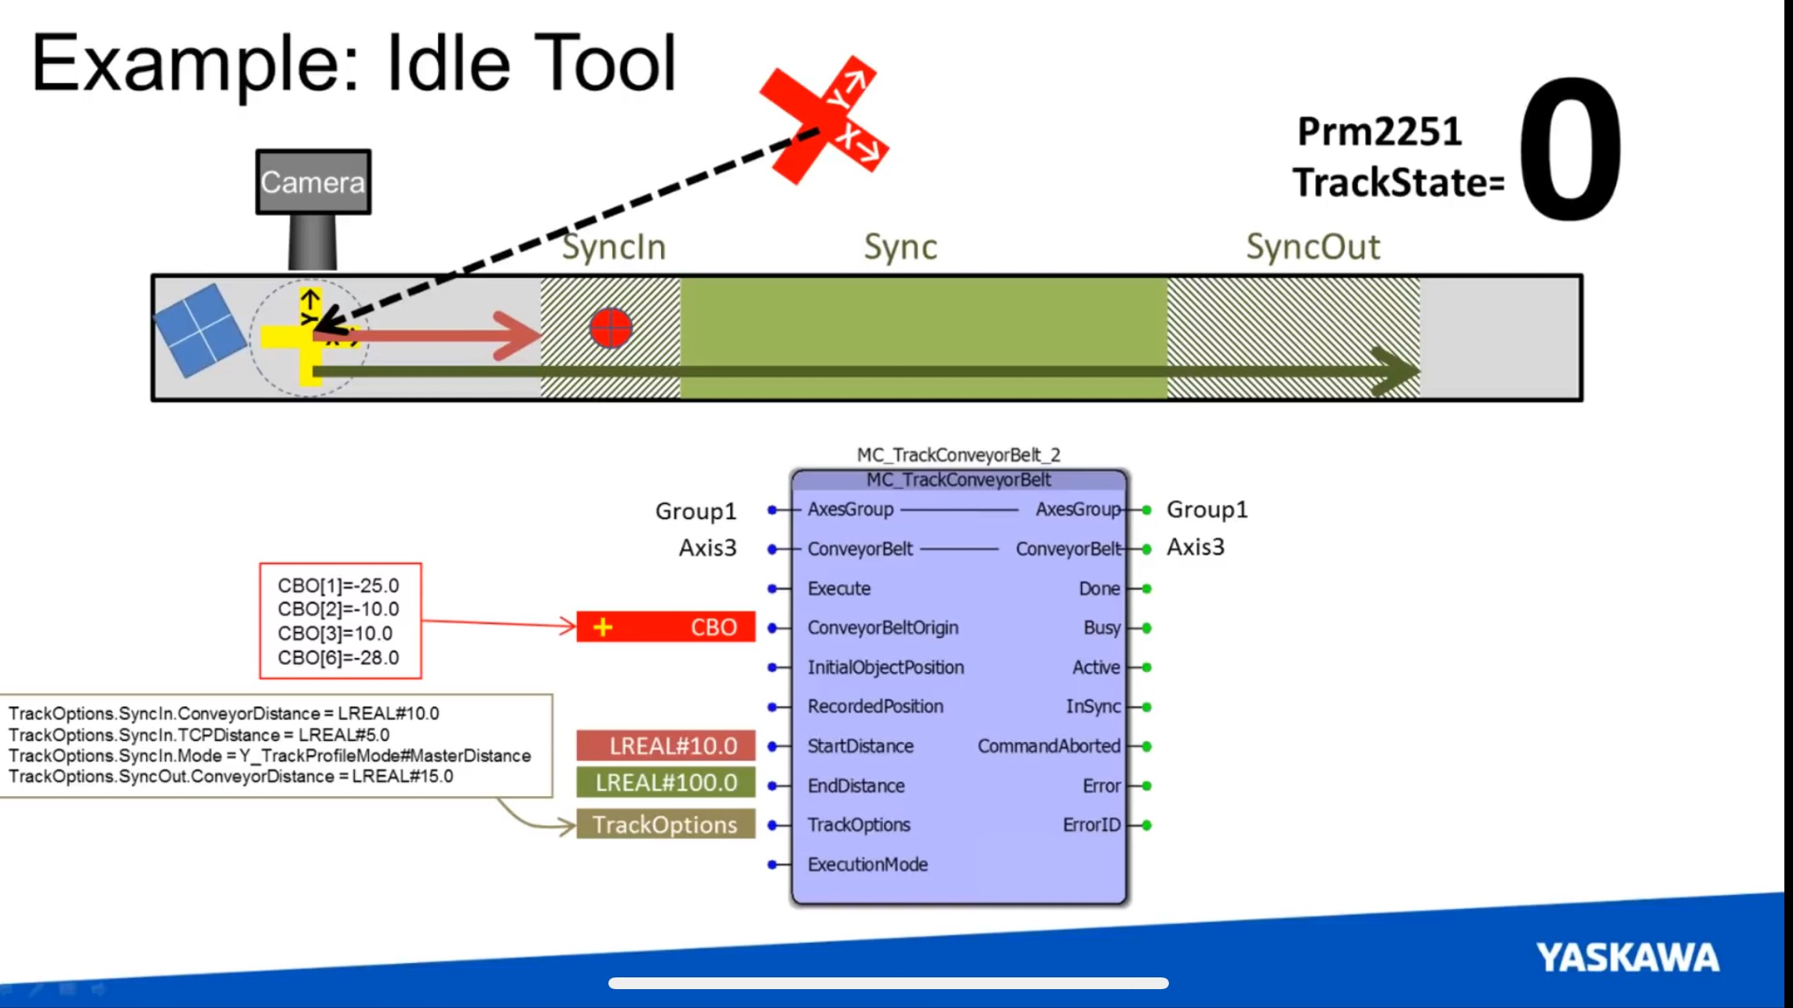

Slide 10
Step3: SYNC zone:
There are three different phases of conveyor tracking:
1) SYNCHRONIZATION
2)TRACKING
3) DE-SYNCHRONIZATION.
These parameters all need to be set to a slightly higher value than the standard parameters of the robot.

Slide 11
IDEA(FLOWCHART)
PHOTONEO camera captures the PCS and picture of the object
Different shaped objects(IN CONVEYOR PLACED)
Signal given to the robot
Sync motion happens
Transfer it to speific target positon
Pick up the object form conveyor

Slide 12
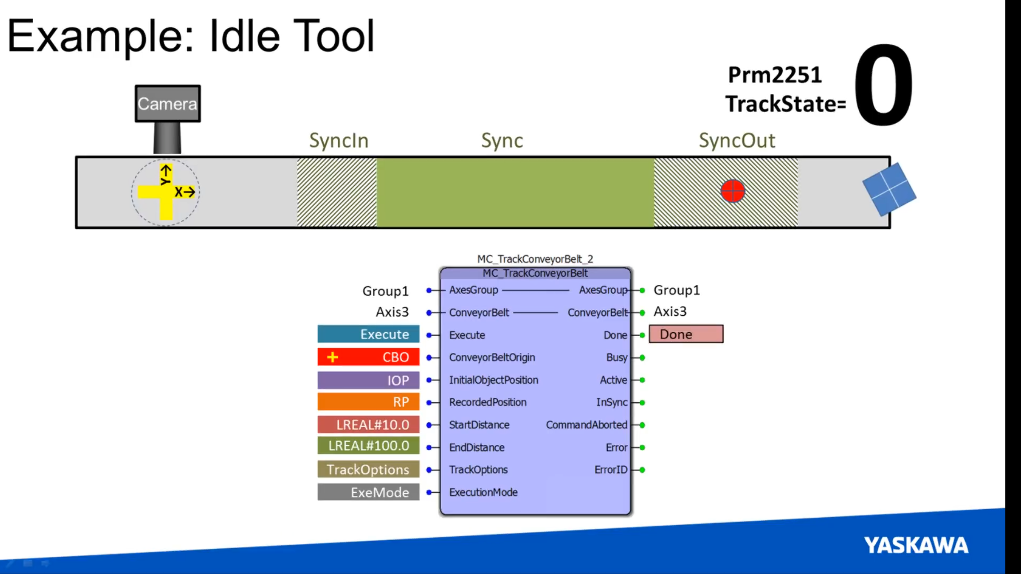

Slide 13
Step4: Execution Mode: (NEURAPY )
Track-conveyor-Belt: The object can be picked in an : IMMEDIATE
Track-conveyor-Belt: The object can be picked in an : DELAYED
Track-conveyor-Belt: The object can be picked in an : QUEUED

Slide 14
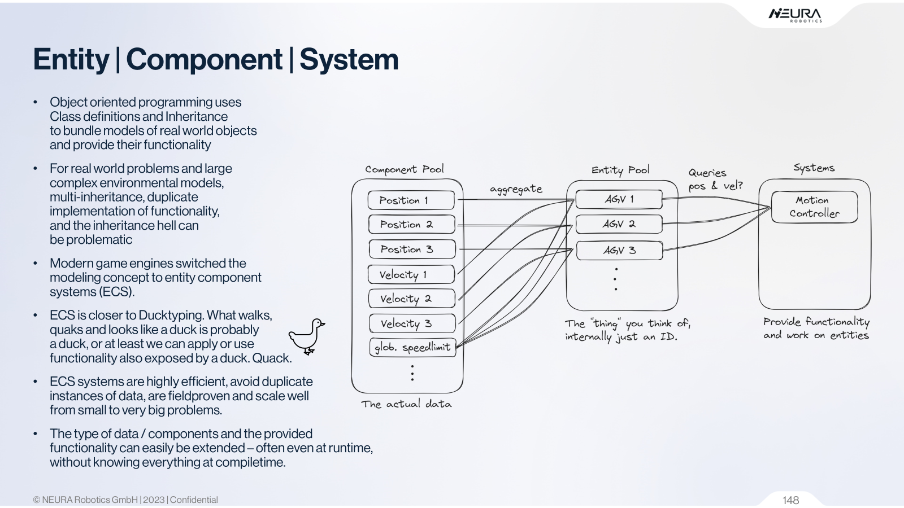
ENVIRONMENTAL MODEL

Slide 15


Slide 16
IMPORTANCE and IMPROVEMENTS:
SCIENTIFIC QUESTIONS:
How can SPEED of conveyor belt can be adjusted the with speed of the ROBOT IN REAL-TIME
How much ACCURACY can be attained while using the VISION CAMERA.
How much TIME does it takes for the robot to pick up the object.
EXPECTED RESULTS:
IMPROVEMENT in Latency of sensor data
Variation in conveyor speed can be TOLERATED BY THE ROBOT IN REAL TIME.

Slide 17
CONCLUSION:
The future scope of conveyor tracking technology is poised to advance significantly, DRIVEN BY INNOVATIONS IN AI, IOT, AND AUTOMATION.
Additionally, advancements in robotics and smart conveyor systems will push the boundaries of automated material handling in sectors like manufacturing, logistics, and e-commerce.

